Slide 1
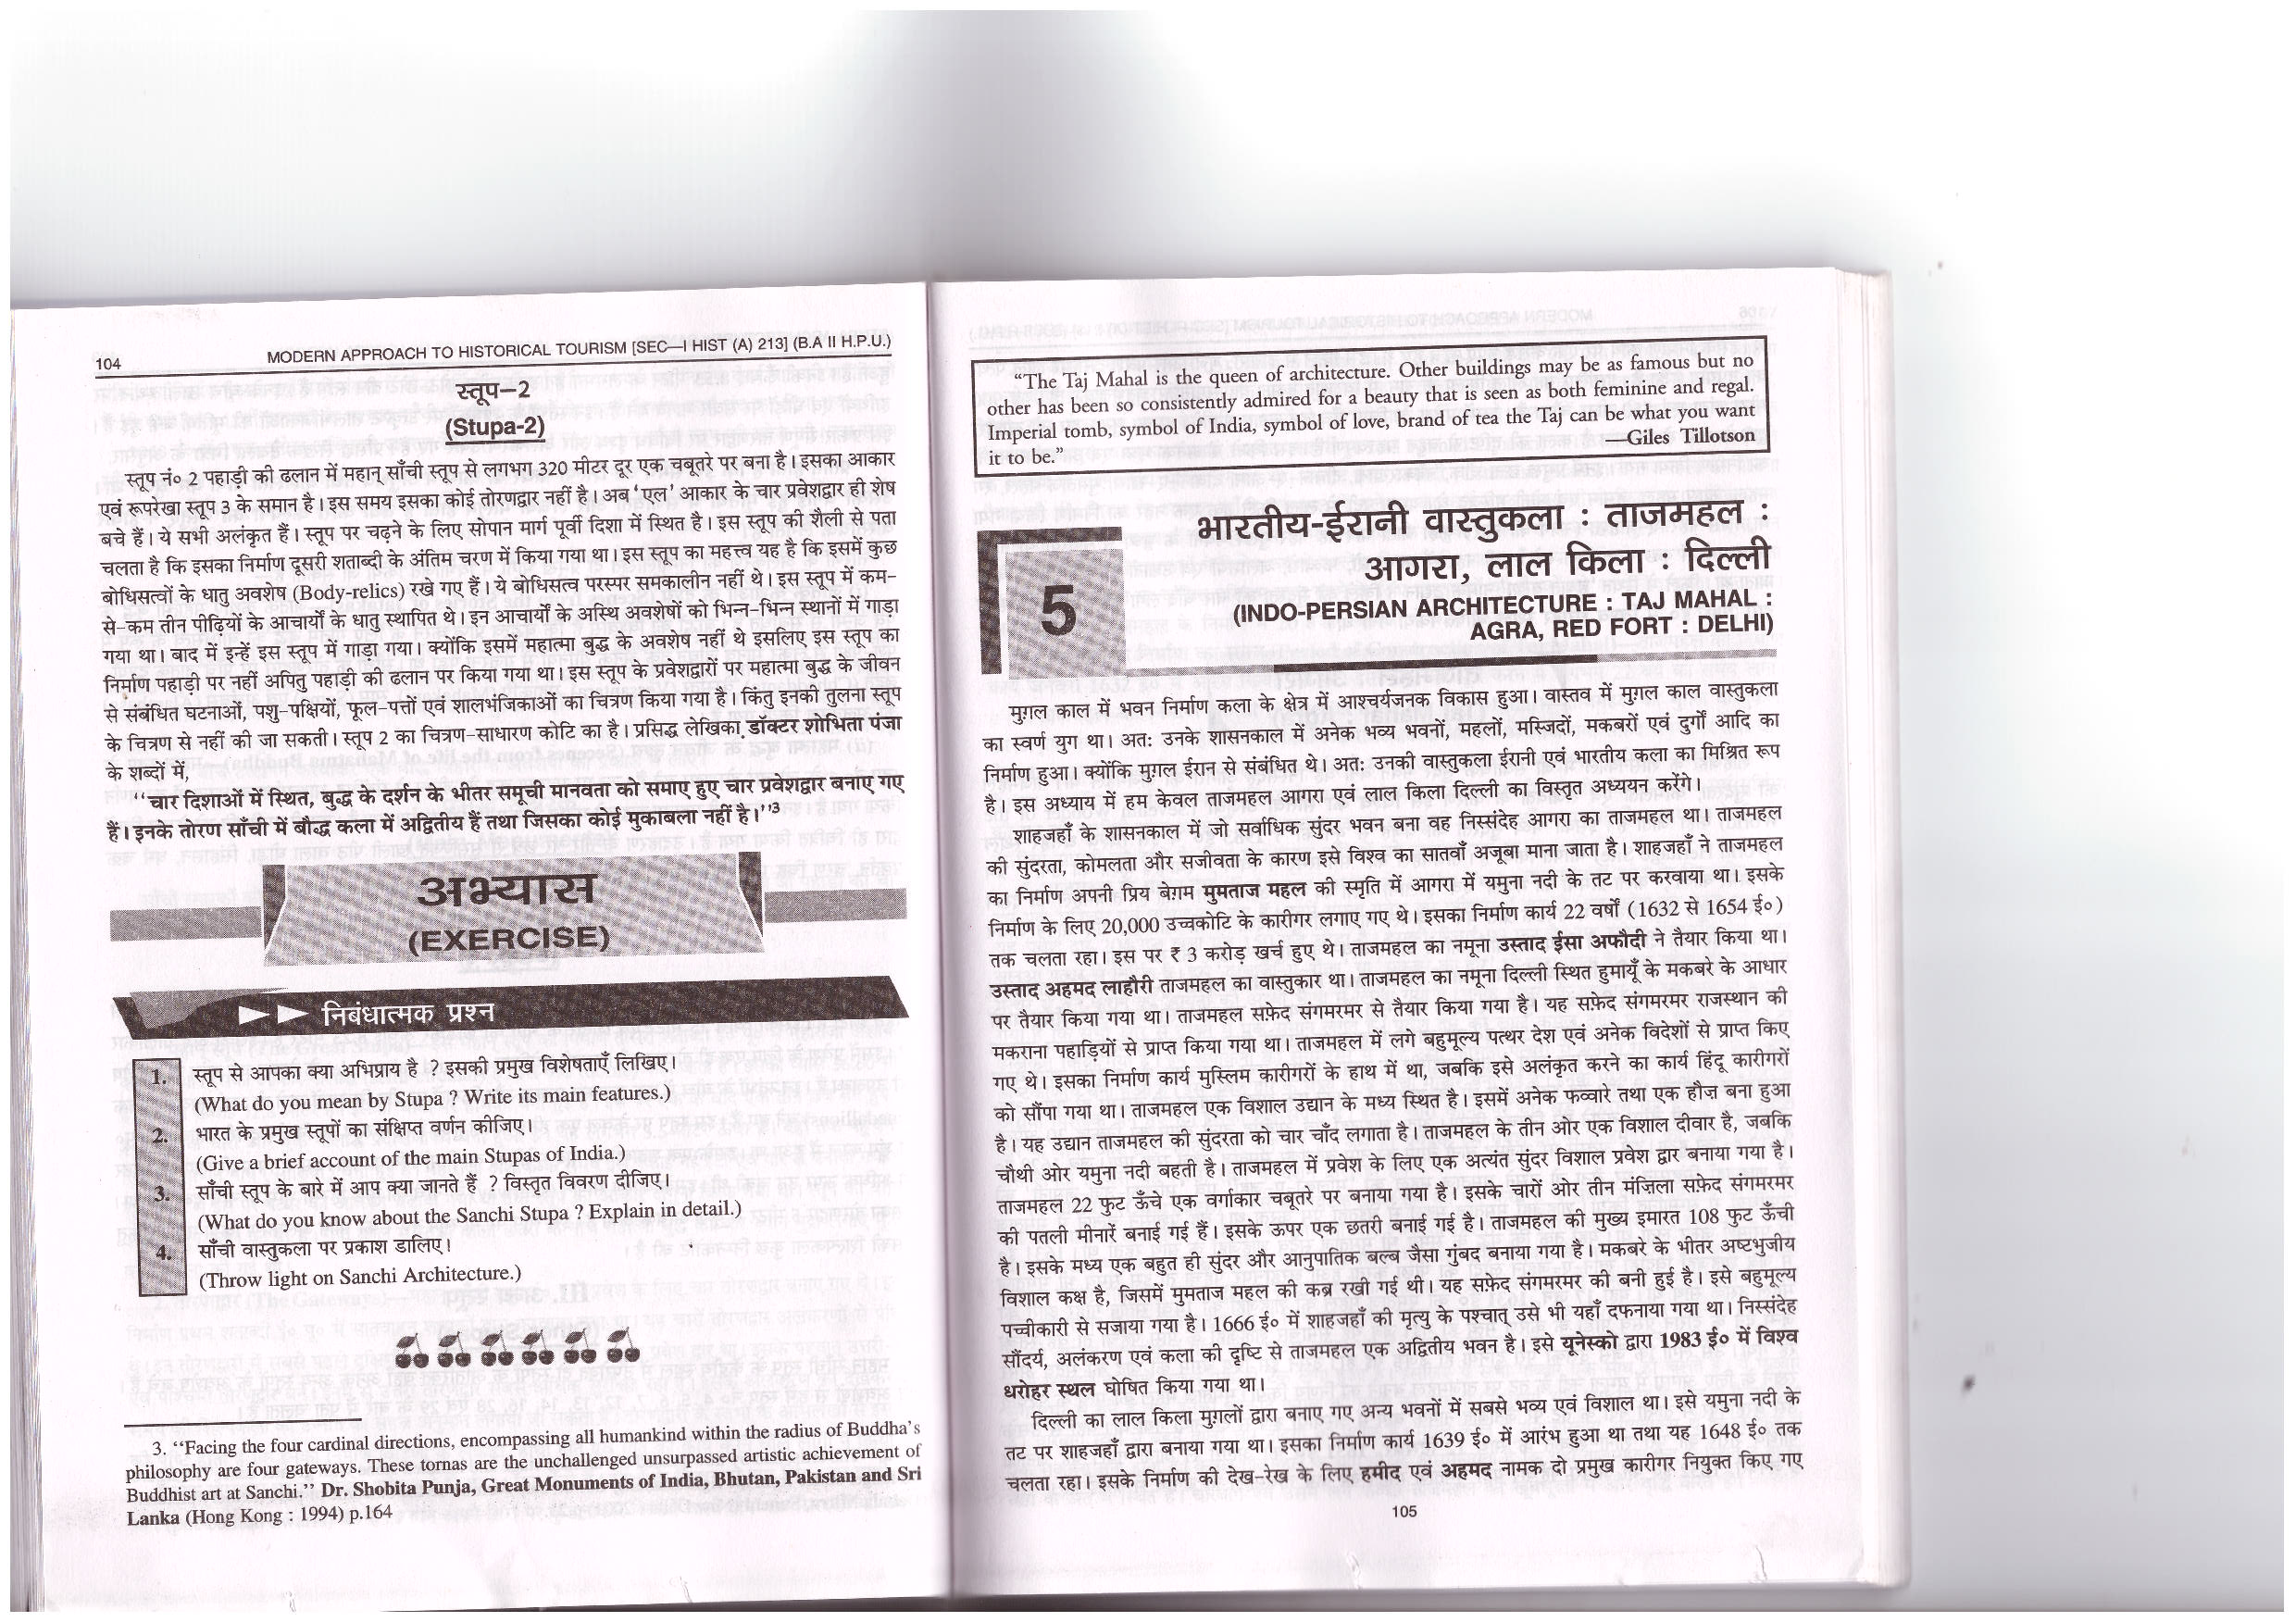
INDO-PERSIAN ARCHITECTURE: TAJ MAHAL: AGRA, RED FORT; DELHI

Slide 2
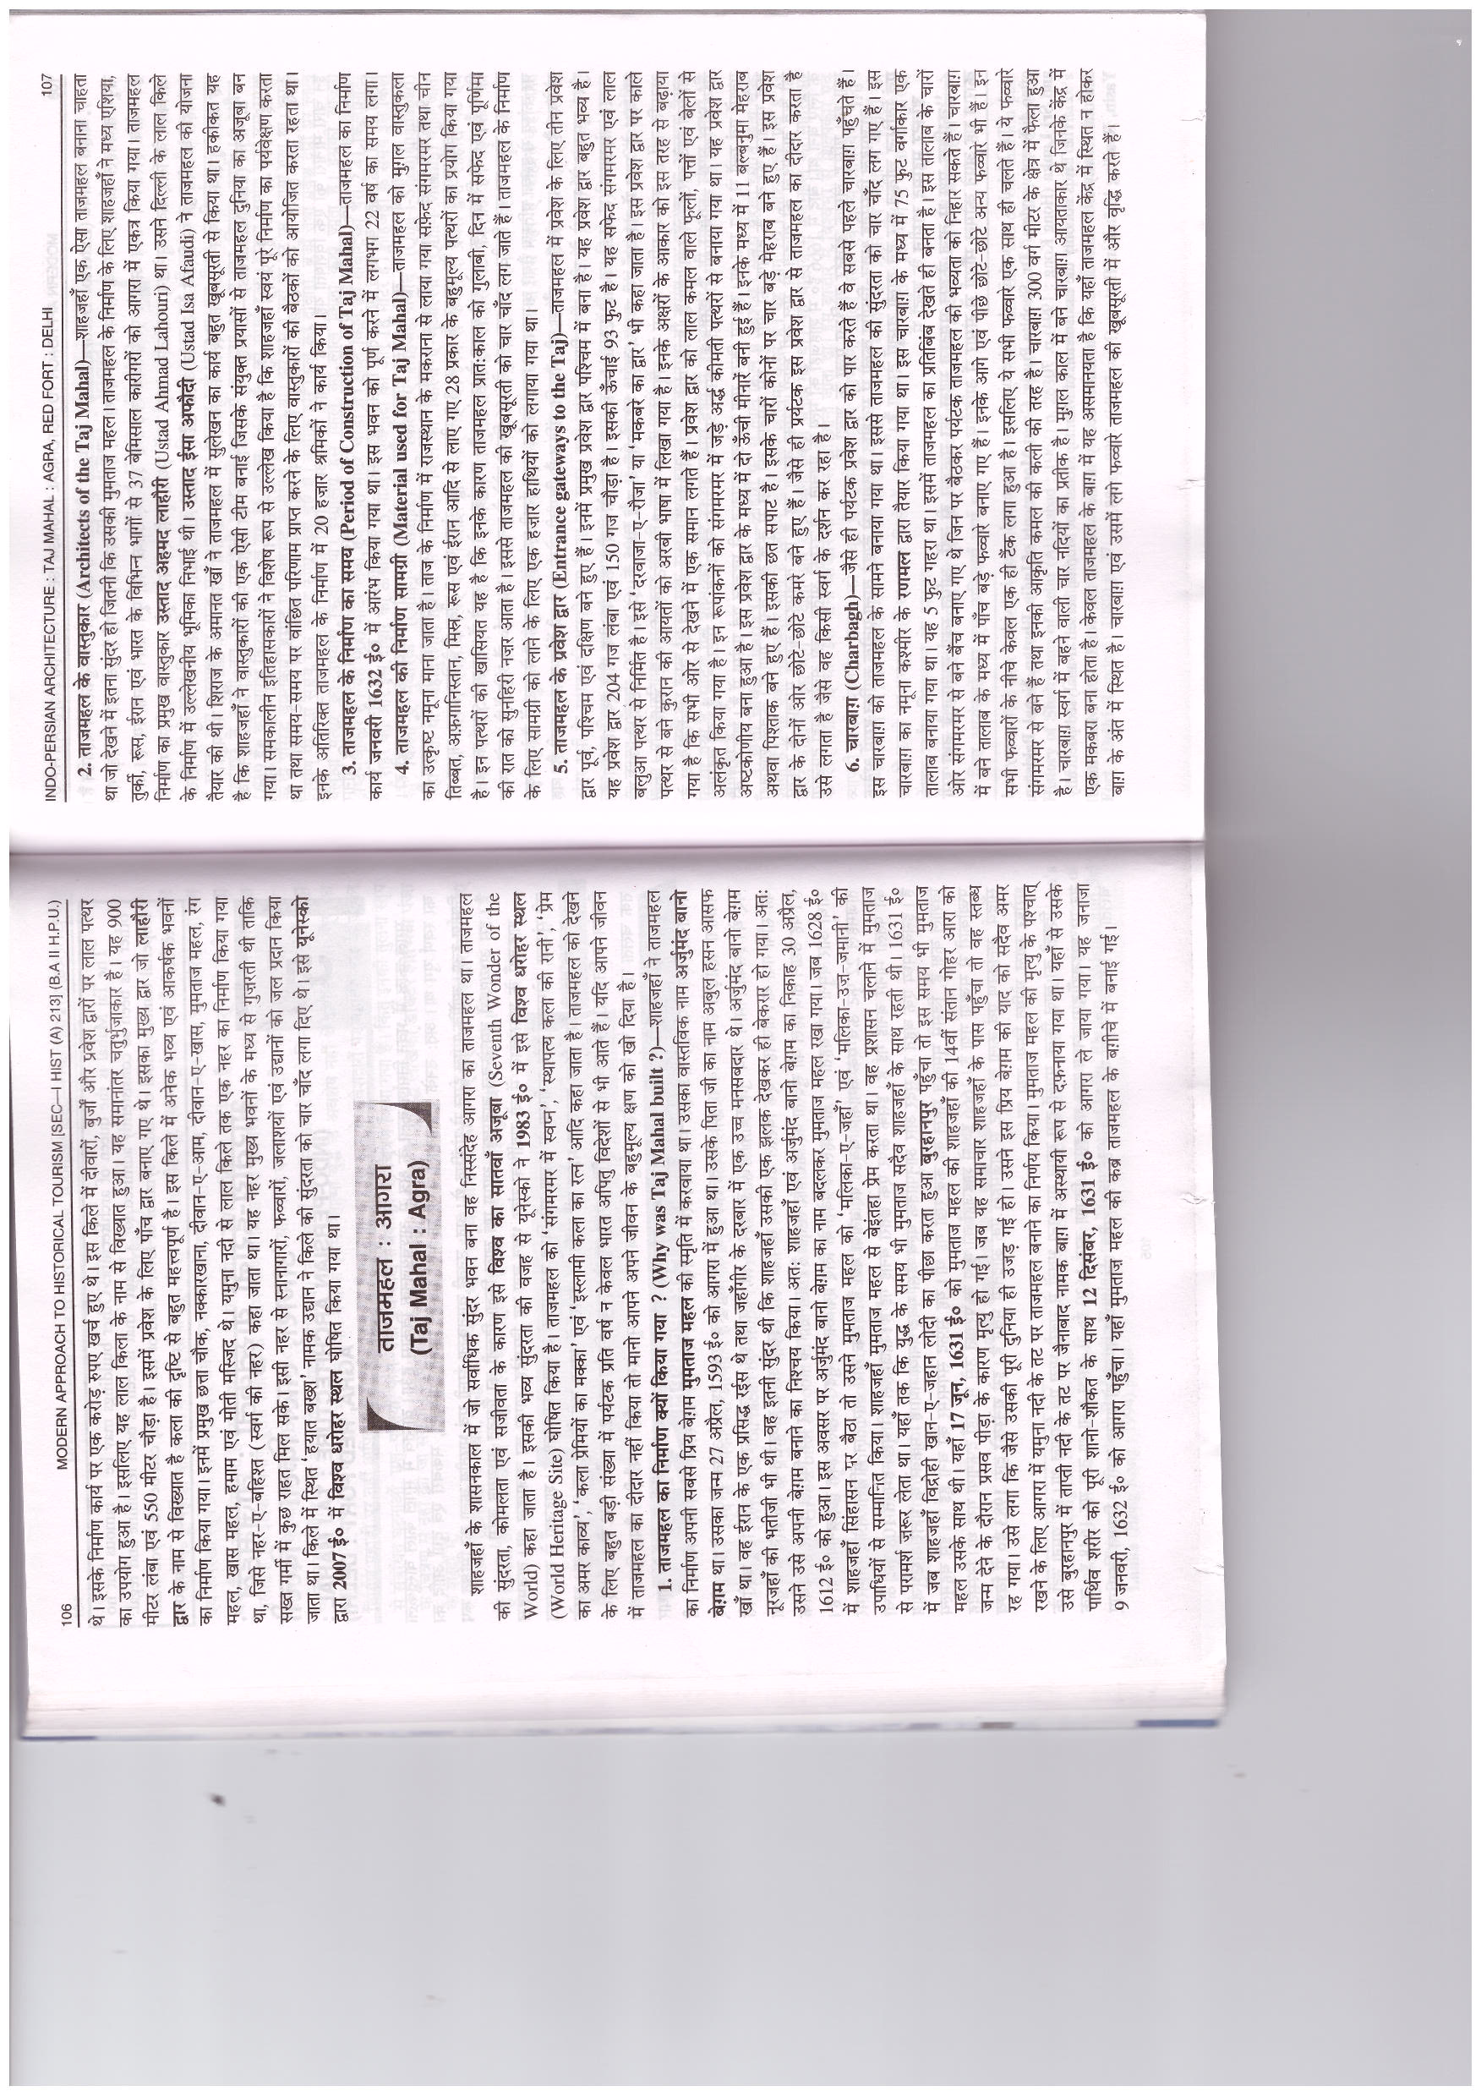

Slide 4
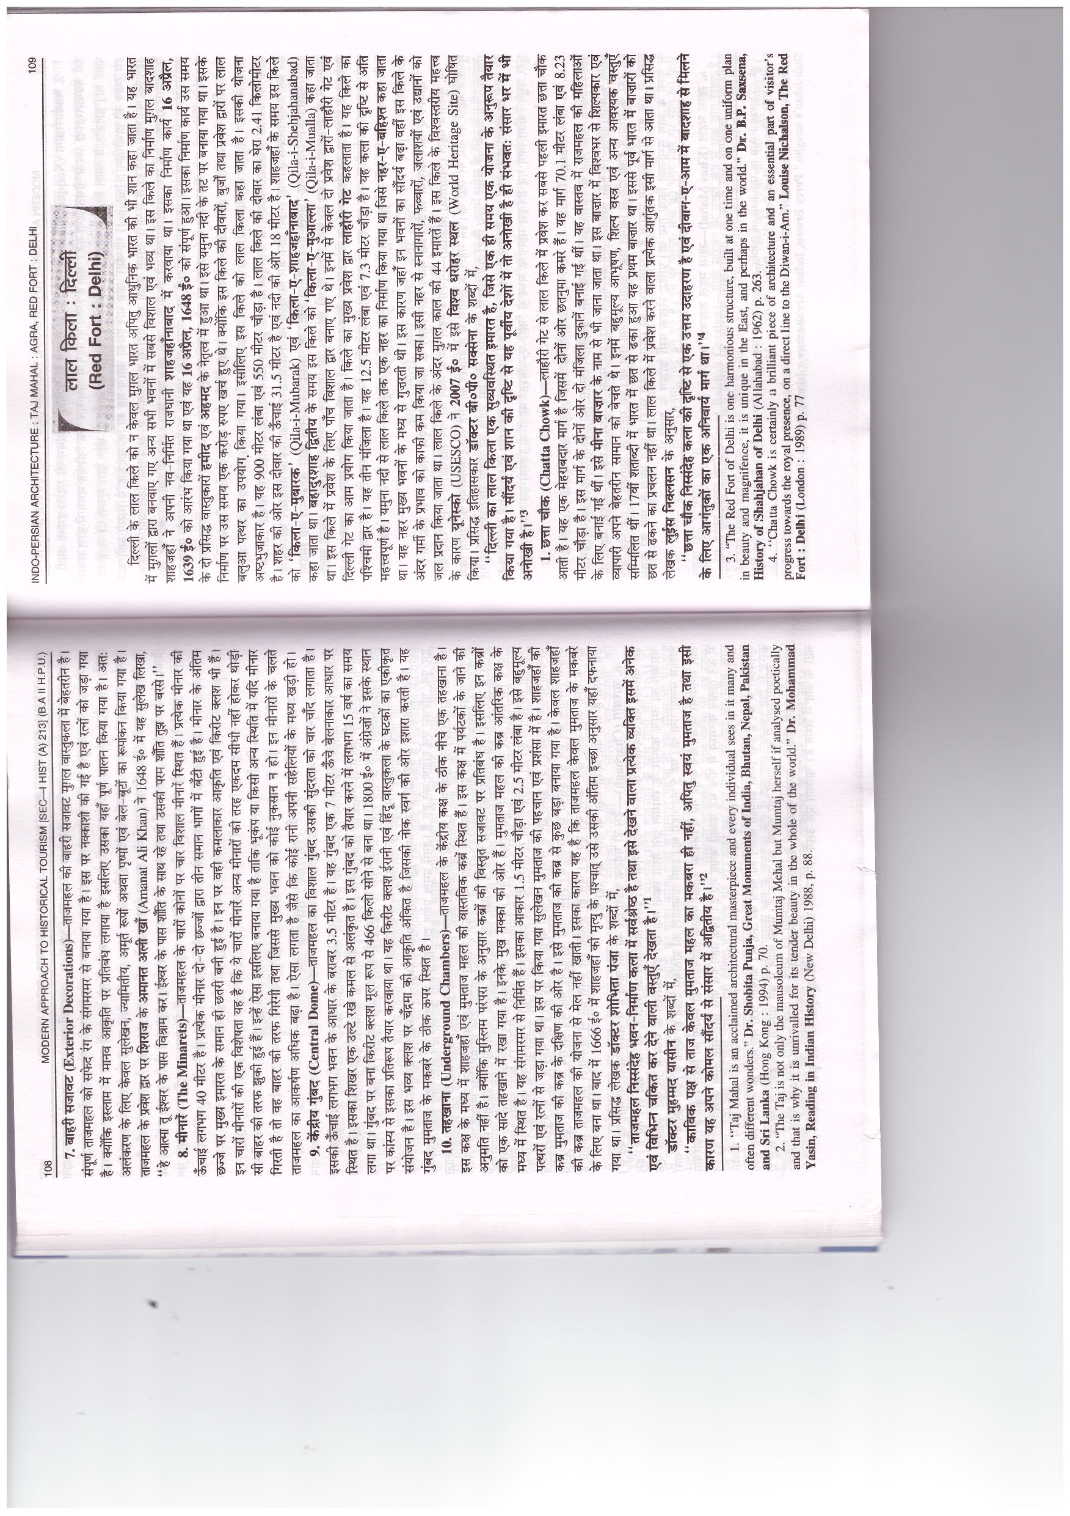

Slide 6
